Slide 1

IBM Professional certificate: Unsupervised Learning - Clustering
Ibrahim Mohamed
August 2022

Slide 2
Main objective
This analysis' primary goal is to cluster bank customers into groups and validate if they are potential customer for term deposit.
So clustering is the main target analysis for unsupervised learning
Show the correlation between the features & the most features with impact.
Validate the clusters with binary classification.

Slide 3
About the data
This dataset is downloaded from The University of California Irvine Machine Learning Repositor.
The data is related with direct marketing campaigns of a Portuguese banking institution.
The marketing campaigns were based on phone calls. Often, more than one contact to the same client was required, in order to access if the product (bank term deposit) would be (or not) subscribed.
This data set has 4521 records and 17 features.

Slide 4
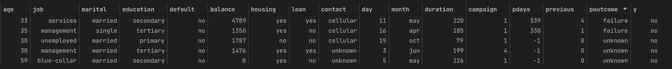
Data exploration
Features:
education: customer education
default: has credit in default?
balance: average yearly balance, in euros
age: customer age in years
Job: customer job
marital: customer martial status

Slide 5
Data exploration
Features:
campaign: number of contacts performed during this campaign and for this client
pdays: number of days that passed by after the client was last contacted from a previous campaign
previous: number of contacts performed before this campaign and for this client
poutcome: outcome of the previous marketing campaign
y: has the client subscribed a term deposit? - TARGET
Housing: has housing loan?
loan: has personal loan?
contact: contact communication type
day: last contact day of the month
month: last contact month of year
duration: last contact duration

Slide 6
Data exploration
Description:
Mean
Std
Max
Min
age: 10
job: NaN
marital: NaN
education: NaN
default: NaN
balance: 3009
housing: NaN
loan: NaN
day: 8
month: NaN
duration: 259
campaign: 3
pdays: 100
previous: 1.6
poutcome: NaN
y: NaN
age:87
job: NaN
marital: NaN
education: NaN
default: NaN
balance: 71188
housing: NaN
loan: NaN
day: 31
month: NaN
duration: 3025
campaign: 50
pdays: 871
previous: 25
poutcome: NaN
y: NaN
age:19
job: NaN
marital: NaN
education: NaN
default: NaN
balance: -3313
housing: NaN
loan: NaN
day: 1
month: NaN
duration: 4
campaign: 1
pdays: -1
previous: 0
poutcome: NaN
y: NaN
age:41
job: NaN
marital: NaN
education: NaN
default: NaN
balance: 1422
housing: NaN
loan: NaN
day: 15
month: NaN
duration: 263
campaign: 3
pdays: 39
previous: 0.5
poutcome: NaN
y: NaN

Slide 7
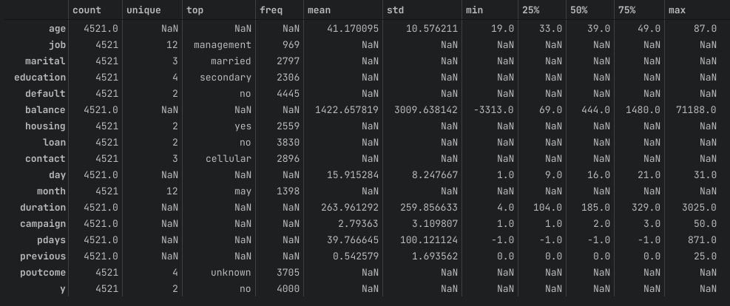
Data exploration
Description:

Slide 8
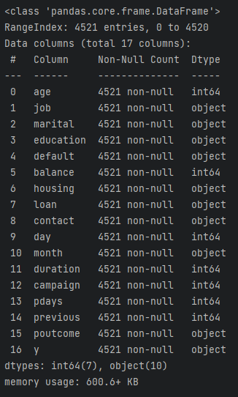
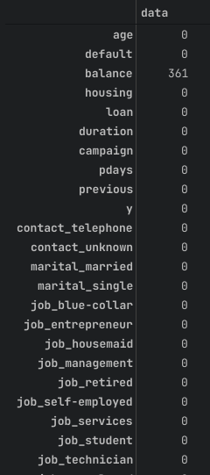
Data exploration
Data Types & Null Values
Our Data Types are the following
Our data doesn’t have any missing values except for balance column which has 361 null value

Slide 9
Exploratory data analysis
Categorical features & Numerical features
Our data contain both categorical features and numerical features
We need to change the categorical data into numerical data.
This is done by splitting categorise into separate columns.
Binary variables: ['default', 'housing', 'loan', 'y']
Categorical variables: ['job', 'marital', 'education', 'contact', 'poutcome']
Numerical variables: ['duration', 'previous', 'pdays', 'campaign', 'balance', 'age']

Slide 10
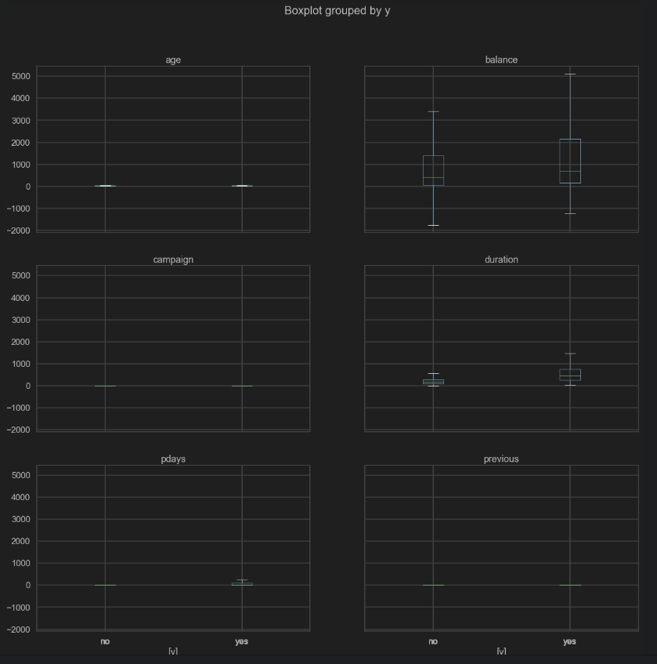
Exploratory data analysis
Identify outliers in the data

Slide 11
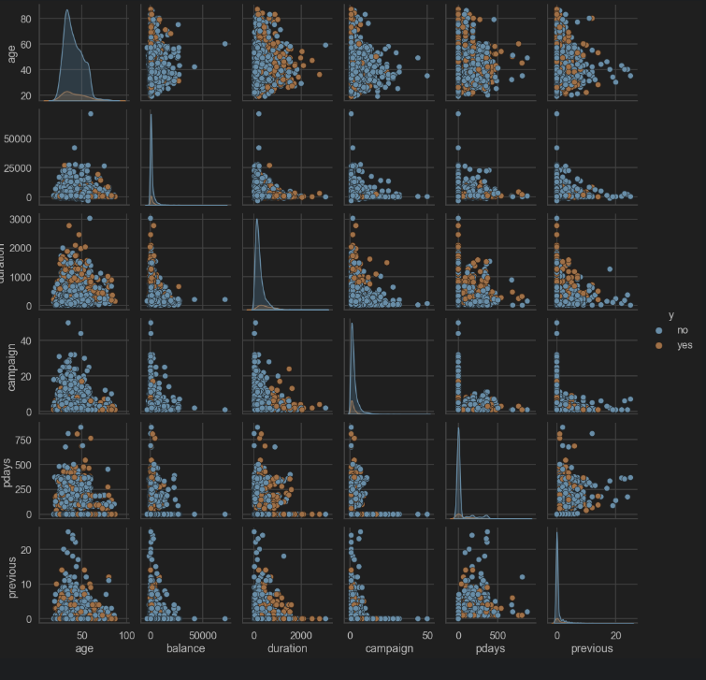
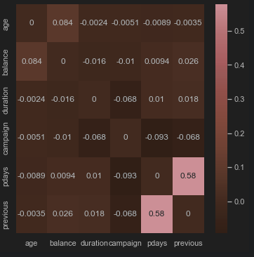
Exploratory data analysis
Correlation between features

Slide 12
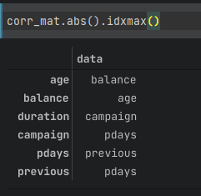
Exploratory data analysis
Correlation between features
These features are most correlated to each other
Age – balance
Duration – campaign
Campagin – pday
Pday – previous
Previous - pday

Slide 13
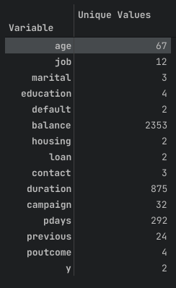
Exploratory data analysis
Feature Engineering
We dropped the un needed columns like day, month.
Get the number of unique values

Slide 14
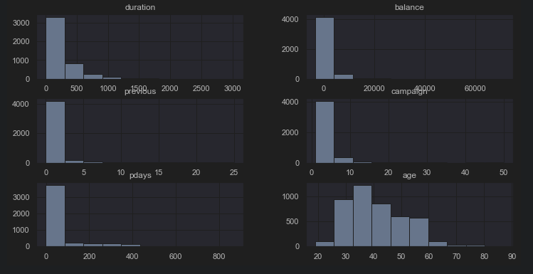
Exploratory data analysis
Feature Engineering
Plot of the numerical values

Slide 15
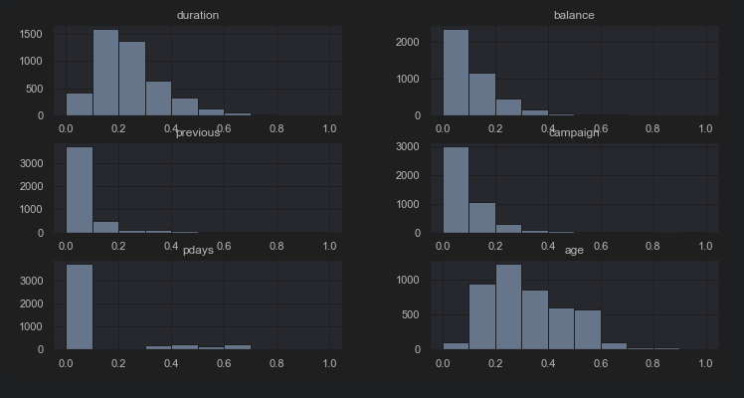
Exploratory data analysis
Feature Engineering
Remove Skew with boxcox1p transformation

Slide 16
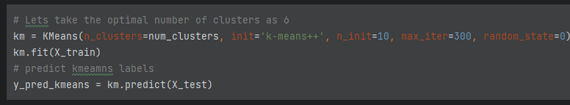
Machine learning analysis
K-Means Clustering
Model Features and Parameters:
Model = KMeans()
N_clusters = 2
Init = ‘k-means++’
N_init = 10
Max_iter = 300
Random_state = 0

Slide 17

Machine learning analysis
Mean Shift Clustering
Model Features and Parameters:
Model = MeanShift()
Min_bin_freq = 10
Max_iter = 1000

Slide 18
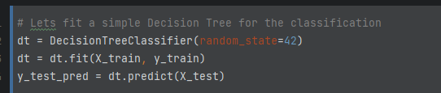
Machine learning analysis
Validation with classification model
Model Features and Parameters:
Model = DecisionTreeClassifer()
Random_state = 42

Slide 19
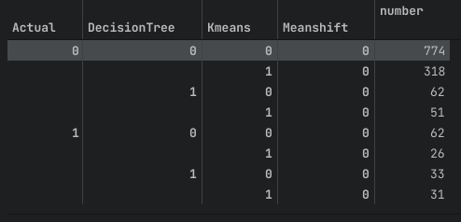
Machine learning analysis
Comparing Models

Slide 20
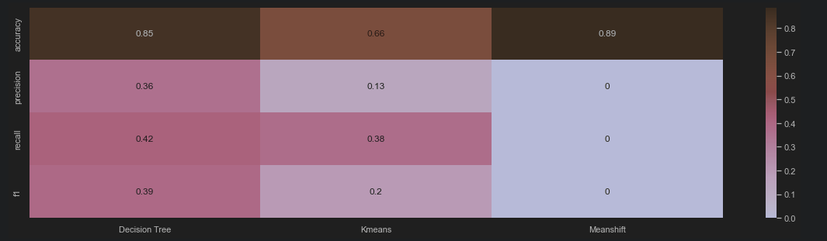
Machine learning analysis
Comparing Models

Slide 21
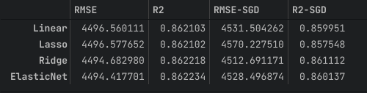
Machine learning analysis
Models Comparison
With the above analysis for Unsupervised Learning, K-Means Clustering perform better than MeanShift Clustering.
MeanShift clustering predicted all the customers into single cluster
Compared to Supervised "Decision Tree" model, K-Means Clustering model performs with the accuracy.
We will conclude, K-Means Clustering model is a good model for unsupervised learning for this dataset.

Slide 22
Analysis Next Steps
Models Flaws and Strength and further suggestions
We have used only small dataset for this assignment. To proceed further, we will use large dataset.
Apart from K-Means clustering model, we can explore other clustering models like DBSCAN, Agglomerative Clustering, etc.
We can use Decision Tree model for classification and run in parallel to K-Means Clustering model in the long run to get better results.

